Slide 1

Subbanarasa Puttana Promotion Template FY2021 Promotion to Manager Expert
Asia Pacific Solutions Delivery Centre
© 2020 CGI Inc.

Slide 2
Personal Information
Name
Designation (Job Code) | Associate Consultant (AC)
Current Role | Technical Architect
Team/portfolio | All Payments
Last Promoted | NA
Performance Rating (Current Year – 1) | EE
Joining Date | 15-May-2016
Promotion Nomination | From: AC | To: ME
Key Stakeholders | Name | Title
Onsite India | Hebert, James Honzák, Tomáš Divín, Roland Jalan, Vikas Venkatraman, Venkatesh Indu, Ulaganayagi Alias | DIRECTOR CONSULTING DELIVERY DIRECTOR CONSULTING EXPERT DIRECTOR CONSULTING EXPERT MANAGER CONSULTING DELIVERY MANAGER CONSULTING EXPERT MANAGER CONSULTING DELIVERY

Slide 3
FY21 Target Summary
 |  | F21 Target | F21 Actuals (YTD) | F21 Forecast
Clients | CSAP Overall | 9.00 | 8.58 | 8.83
 | CSAP – Innovation | 9.00 | 8 | 8.00
 | CSAP – Technology | NA | NA | NA
 | CSAP – Quality | NA | NA | NA
 | OSAP | 9.00 | 8.9 | 9.0
 | Red Engagements | 0 | 0 | 0
Members | MSAP | ≥8.50 | 9.22 | 9.25
 | Voluntary Turnover | 10-12% | 17% | 15%
 | SPP Participation | 100% | 100% | 100%
 | Freelancers numbers | ≤ 2% | 0 | 0
 | Member Referral % | ≥40% | 37.5% | 43%
 | Diversity Ratio (F:M) | ≥45% | 30:70 | 40:60
Shareholders | PCB Revenue (CAD$ Mn) | 1275633 | 1491698 | 1341143
 | Gross Margin % | 23% | 23% | 23%
 | Utilization % | 95% | 104.77% | 95%
 | Contribution (CAD$ Mn) | NA | NA | NA
 | Contribution % | NA | NA | NA
 | Total BU SG&A %

Slide 4
Top 3 accomplishments - Clients
Key Areas to indicate accomplishments on | Accomplishment | Contribution | Impact
Client Relationship and Business Development | Become a Technical counterpart of Client and onsite technical team. Designed the PDE micro service for NBC without major impact on monolithic product architecture. Played critical role on Dual cloud and CI-CD implementation like Failover scripts and Kafka reset Job. | Active participant in Architectural design of the Product. Helped project team to kick start of Kafka stories in APS8 and migration project | Able to deliver high quality Microservices Suggested to spring 5.x upgradation before doing spring boot upgradation.
Technical Expert | SPOC for the new technology POC’s and implementations. Ex: Kafka, Apache POI, Elastic, Kinesis. Provided design suggestion in Micro services and Helped Product team on Kafka technical clarification. Become expertise on Docker, k8s and Cloud. | Kafka POC, Design and implementation in Product. Provided technical help on design of REST services. Contributed to identify and fix the workflow performance issues | Well respected for technical views by Onsite and client due to good analysis backed-by data/logic/evidence. As a full stack expert able to deliver end to end solutions.
Innovative solutions towards Operational Excellence | To put all the monitoring tools in place. Expertise skills on performance and cloud PR/DR failover. Helped to setup CI/CD pipeline and build tools. | Helped to Integrated Prometheus and Grafana. Provided Initial implementation of Locust for Performance testing. Fluent integration with AWS kinesis. | Able to get notifications on deployment failures. Easy to run performance testing. Able to monitor the APS events via Splunk

Slide 5
Top 3 accomplishments - Members
Key Areas to indicate accomplishments on | Accomplishment | Contribution | Impact
Development of Expertise (self and team)/Coaching and development of team members | Done AWS and Kafka Certification. Conducted 10+ of Internal Knowledge Sharing sessions. | Conducting regular sessions at internally within the team. Helped on Migration on Angular and Rest services. | Members are proactively participated in knowledge sharing sessions.. Improved soft and presentation skills
Technical knowledge sharing | SPOC of Product Tech stack , Kafka and Micro services presentation on SBU level. Driving the technical sync up meeting of all the technical experts. | Presented APS Technical Architecture in Product show. Presented CGI GIT and Micro-services patterns. Given Technical help to Trade team on beanio parser. | To familiarize APS Tech stack and Kafka by members. To understand Dual cloud and DevOps implementation in APS by members. Unblocked Java upgradation and Groovy issues
Team and member management | Participated the hiring process and weekend drives | Follows Agile way of development and team collaboration. Actively participated in hiring process. | Team collaboration is improved. Quality hires and no onsite interview

Slide 6
Top 3 accomplishments - Others
Key Areas to indicate accomplishments on | Accomplishment | Contribution | Impact
ICE/Innovation contributions | Collected 25+ Project level ideas and shortlist to do the POC’s I have designed and implemented 1 POC (MTMX). Posted Generic Simulator Idea | Motivated the team to contribute improvement in the project. Given design and technical solution to the POC’s. Given demo to onsite and internal members on 2FA. Helped on APS Dashboard implementation | One of project level idea we are using it in our team. Other project members asked MTMX convert for integration. APS Dashboard is helpful for the members.
Visibility in, stretch on and contribution towards other projects/programs | Given estimation for REST API for other projects. Suggested SMS Notification services solutions. Given Kafka design help for the APS8. | Given REST API implementation estimation for other CGI Projects (BEMO Bank), Given technical help to OG360 on Kafka Integration. Helped ARM team in Cloud SMS notifications | Other team able quickly implement the solutions. Helps validate their estimations. Able to kick-start Kafka integration into microservices.
AWS, DevOps and Kafka Certification | First person who has done Kafka certification from SBU level Certified AWS cloud and Azure fundamental. Done the DevOps Certification with K8s | Given solutions for the Kafka integration in new version of Product. Involved in Kafka technical conferences Given training to onsite and other project members. | Single point of contact for any Kafka and DevOps Able to solve any Kafka issues within the team and onsite team. .

Slide 7
Status of Individual Development Plan (IDP)
 | Development goals: AWS and Kafka DevOps Micro services | Development action | Date | Status
 |  |  |  | Q1 FY21 | Q2 FY21 | Q3 FY21 | Q4 FY21
 |  | Develop knowledge on Cloud and Kafka technologies. | Jan-2021 | IP | PL | PL | PL
 |  | Develop DevOps skills with internal and external trainings | May-2021 | NS | IP | PL | PL
 |  | Develop in depth knowledge on Micro services | July-2021 | NS | NS | IP | PL
From your SDP document, please fill in the status of your Individual Developmental Plans as discussed with your manager
NS: Not Started; IP: In progress; PL: Planned

Slide 8
Top 3 challenges for FY21
Challenges | Plan
To increase sprint velocity and reduces post delivery defects. Reduce number of iterations during client NFR testing. Streamlined build and Release process across DEV-MS team | Utilized the sprint planning time to clarify and identify technical challenges. Utilizing the cloud environment and DevOps to minimize integration issues. Giving early build and parallel testing automation and manual. Run NFR testing locally before running in client environment which help in proactive identification many issues. Ex: Spring 5.x, Hibernate 5.x, Tomcat 8.x Deploy it practice environment which bridge DEV-MS team before install in SIT, UAT, PREPROD and PROD servers. Automated release process with Jenkins pipeline, Docker and k8s

Slide 9
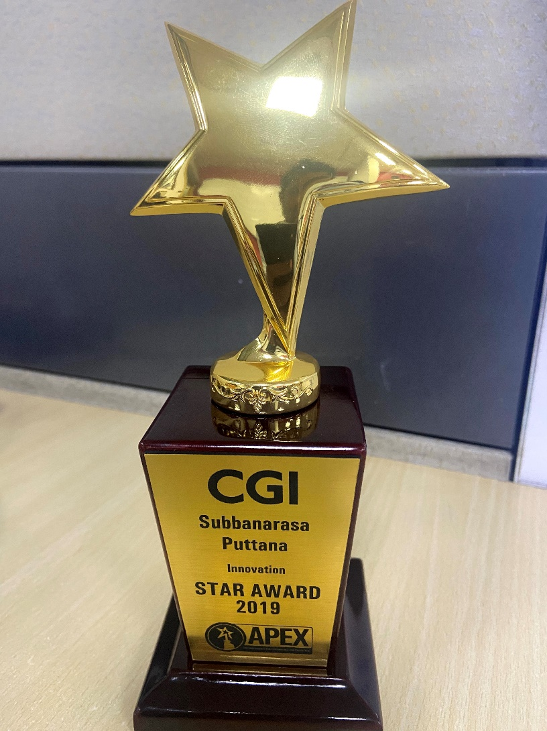
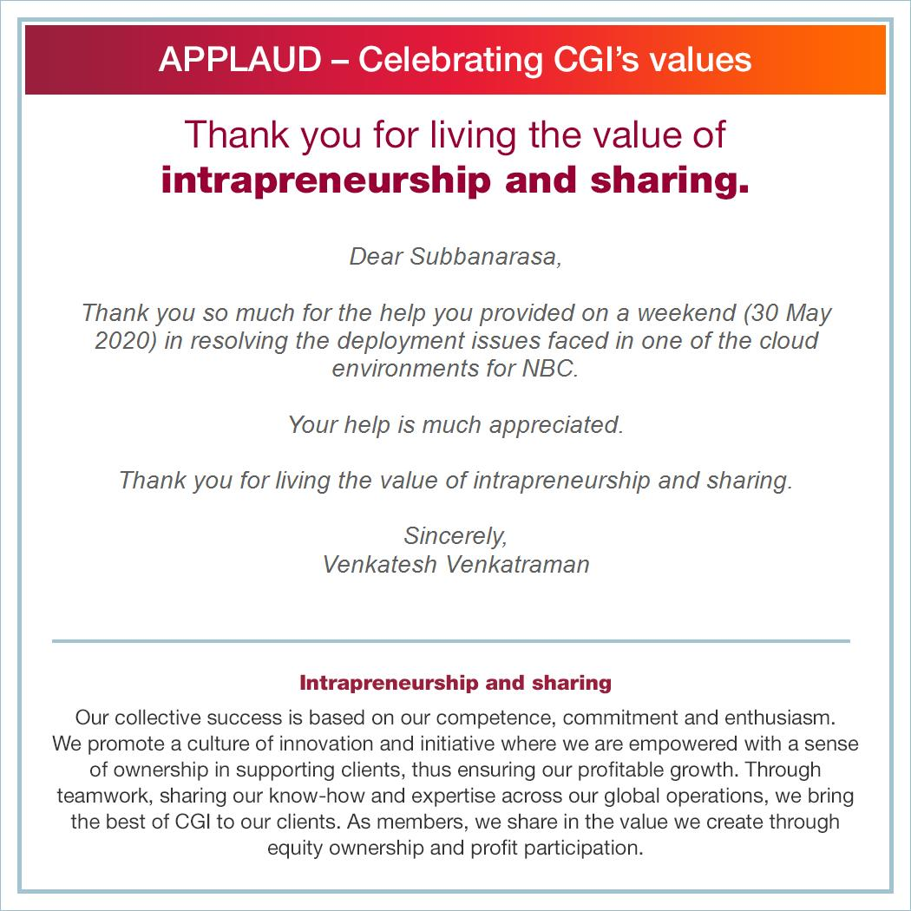
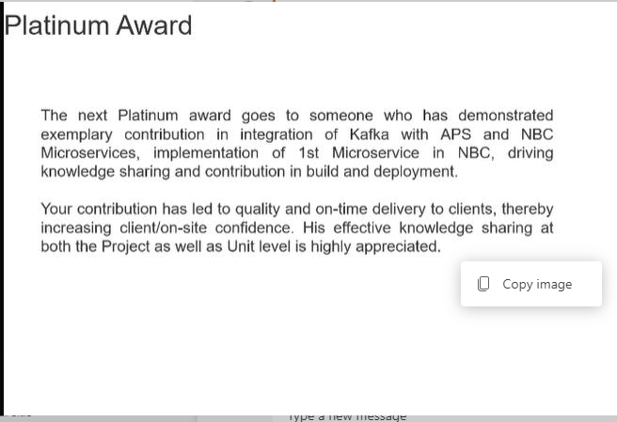
Awards and Applaud

Slide 10
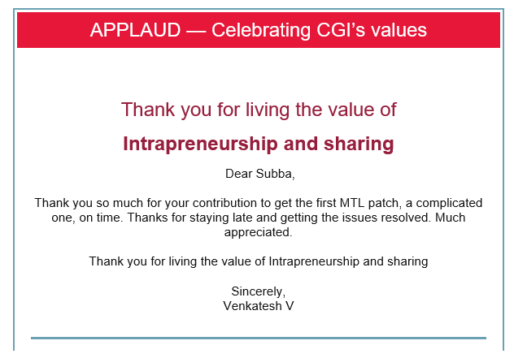
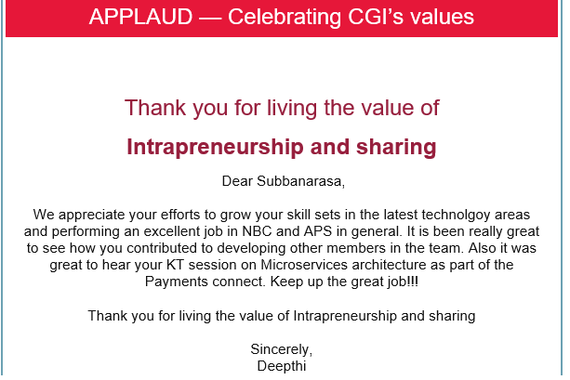


Continues..

Slide 11
Certifications
Confluent Certified Developer for Apache Kafka
DevOps Plus – K8s
Sun Certified Programmer for Java
Python for Data science Expert
AWS Cloud professional
MongoDB for Java Developers
Docker
Microsoft Certified : Azure fundamentals

Slide 12

Thank you

